Slide 1
Second Quarter 2025 Chartbook
Data as of March 31, 2025
--Rep Name
--Firm-Approved Title
--Registered Branch Address
--Approved Email and/or Registered Phone
--Securities Disclosure
Enter all information and submit to Ad Review for final approval

Slide 2
Second Quarter 2025 Outlook
Economy – Signs of Slowing
  A cooling labor market and tepid business investment are signaling a moderating economy.
  Inflation remains firm above the Fed’s 2% long-term target, and tariffs could add to price pressures near-term. However, the Fed’s preferred inflationary gauge, the core PCE price index, is stabilizing.
Equities – Uncertainty Driving Volatility
Market volatility ramped up in the first quarter, driven by tariff uncertainty, economic growth concerns, and high valuations.
International equities are outperforming in this environment despite tariff risks. Dollar weakness and Europe’s shift away from austerity could propel momentum overseas in the near-term, adding value to a diversified allocation.
Fixed Income – Yields Range Bound
Bond yields have been in a wide range this year, as the near-term growth outlook has weakened, and tariff-related volatility impacted the bond market.
Credit spreads have increased but remain relatively narrow despite the uptick in equity volatility in the first quarter. The bond market isn’t pricing in as much downside risk to the economy compared to the stock market, which has corrected.

Slide 3
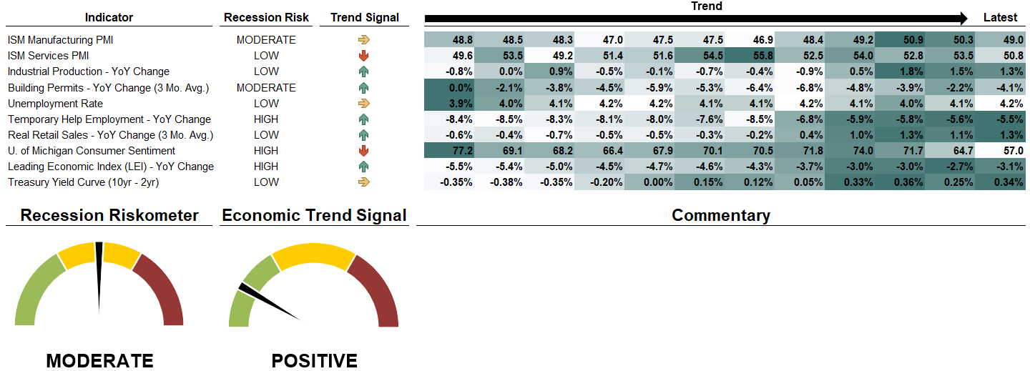
U.S. Economic Risk Overview
The dials on the left show our combined estimate of near-term recession risk and direction of economic growth, based on the average reading of ten economic indicators. The Recession Riskometer focuses on producer sentiment, output and manufacturing growth, employment, consumer strength and leading economic indicators.
One of our key themes for 2025 is that the economy is likely to moderate. This has held true through the first quarter of the year. While consumers remain resilient, uncertainty tied to tariffs is denting both consumer and business confidence. Traditional recession indicators are flagging a moderate risk of recession, as captured by the Recession Riskometer. Five of ten indicators in our Recession Riskometer are signaling a low recession risk, two indicators are signaling a moderate risk, while three indicators are signaling a high risk of recession. The economic trend signal is positive.

Slide 4
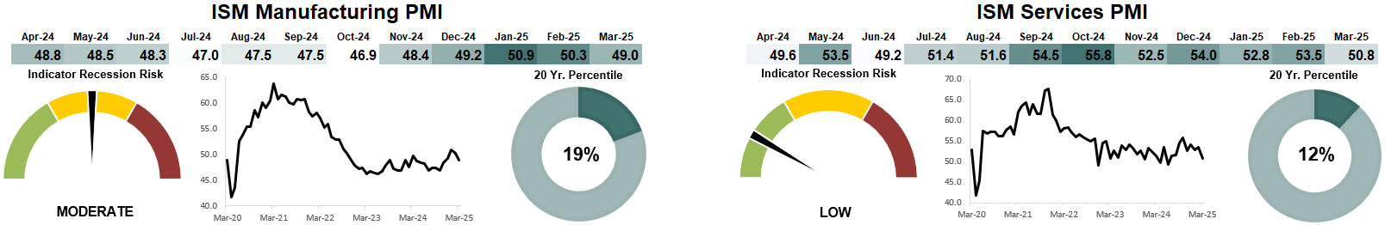
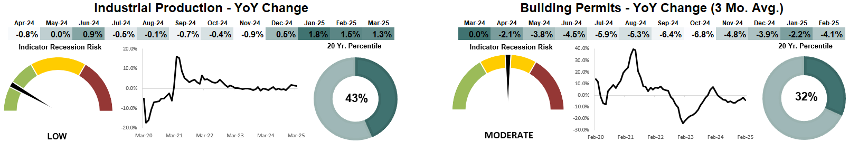
U.S. Economic Risk Indicators
The ISM Manufacturing PMI fell to 49.0 in March, easing back into contractionary levels (below 50 signals contraction). This index is in the 19th percentile over the last 20 years.
A reading over 50 indicates expansion, below 50 signals contraction, and in the mid 40's suggests recession.
The ISM Services PMI slowed to 50.8 in March. While the service sector remains in expansion, it was the weakest reading in 9-months. This indicator is in the 12th percentile over the last 20 years.
A reading over 50 indicates expansion, below 50 signals contraction,
and in the mid 40's suggests recession.
Industrial Production activity increased by 1.3% YoY in March, signaling a low recession risk for the industrial economy. Industrial production growth is in the 43rd percentile over the past 20 years.
Industrial Production Index measures real output for manufacturing, mining, and utilities. The YoY change in Industrial Production signals a high risk of recession when it falls into negative territory. There is a low recessionary risk when greater than 1%.
The 3-month average of building permits fell 4.1% YoY through February, signaling a moderate recession risk for housing. The current permits reading is in the 32nd percentile over the past 20 years.
Building Permits are a measure of the issuance of permits to build new housing units. Building permit growth is a measure of the total year-over-year percentage change in building permits (3-month average). This indicator signals a high recession risk when growth falls below -15% YoY.

Slide 5
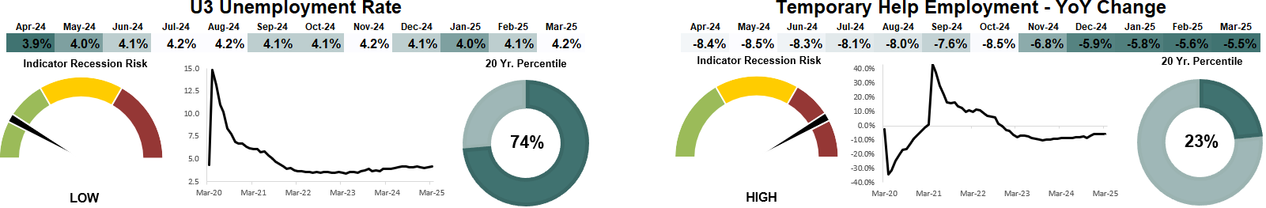
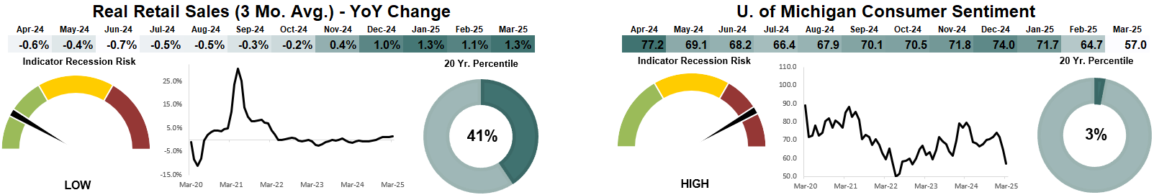
U.S. Economic Risk Indicators
The unemployment rate increased to 4.2% in March. Job growth accelerated in March, but the 12-month average is below pre-pandemic levels. The current reading is in the 74th percentile over the last 20 years.
The U3 Unemployment Rate measures the percentage of people without jobs who are actively seeking work. This is often the officially quoted unemployment rate.
Temporary help employment growth fell 5.5% year-over-year in March, marking the shallowest decline since January 2023. Temporary help employment is a leading indicator for the labor market. A declining trend is viewed as a warning sign.
Temporary help employment figures are viewed favorably if they are positive and trending higher. Changes in temporary help numbers are often used as a predictor of changes in future employment.
The 3-month average of Real Retail Sales rose 1.3% YoY in March. A surge in auto sales drove retail sales higher in March. This indicator is in the 41st percentile over the last 20 years.
Real retail sales growth is a measure of the total change in retail and food sales adjusted for inflation using the Consumer Price Index. Real retail sales typically decline heading into a recession.
The University of Michigan Consumer Sentiment index fell to 57.0 in March, declining for the third straight month. The current consumer sentiment reading is in the 3rd percentile over the last 20 years.
Strong consumer confidence is a positive signal for future consumer spending, but it is a concern if this indicator is trending lower. The index uses surveys to gather information on consumer expectations regarding the economy.

Slide 6
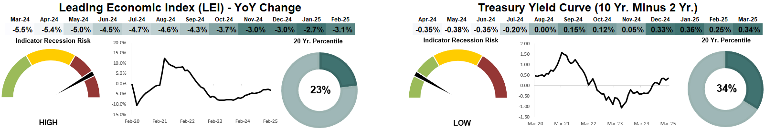
U.S. Economic Risk Indicators
The Leading Economic Index (LEI) declined 3.1% year-over-year in February, the 31st consecutive negative reading. The LEI is in the 23rd percentile over the last 20 years. The LEI signals a weakening outlook for the economy when it drops into negative territory.
The Conference Board Leading Economic Index (LEI) is a composite index of several U.S. economic indicators that lead the economy. This indicator historically has declined in recessions and rises back into positive territory in expansions.
The 2-10 treasury yield curve spread was 0.34% at the end of March. An inverted yield curve signals an elevated risk of recession over the next 12 to 24 months.
The difference (spread) between the yields of the 10-Year and 2-Year maturity Treasury bonds is one of the early and reliable predictors of a recession. Under normal conditions the 10-Year/2-Year spread is positive, and as recession nears the spread flattens and turns negative. This indicator will shift to high recession risk when the spread is below zero.

Slide 7
Sector Valuations

Slide 8
Fixed Income Overview
 | Yield
 | Index |  | Current |  | 20 Yr. Avg.
 | Bloomberg US Treasury Bill 3 Mon. |  | 4.30 |  | 1.57
 | Bloomberg US Treasury 1-3 Yr. |  | 3.93 |  | 1.50
 | Bloomberg US Treasury 7-10 Yr. |  | 4.16 |  | 2.46
 | Bloomberg US Treasury US TIPS |  | 4.22 |  | 2.44
 | Bloomberg Municipal |  | 3.85 |  | 2.91
 | Bloomberg GNMA |  | 4.91 |  | 3.14
 | Bloomberg US Corp IG |  | 5.15 |  | 4.17
 | Bloomberg US Corporate High Yield |  | 7.87 |  | 7.91
 | Bloomberg US Aggregate 1-3 Yr. |  | 4.13 |  | 1.87
 | Bloomberg US Aggregate Bond |  | 4.60 |  | 3.28
 | Bloomberg Global Treasury Ex. US |  | 2.66 |  | 1.46
 | Spread vs 10-Yr Treasury Yield
 | Index |  | Current |  | 20 Yr. Avg.
 | Bloomberg Municipal |  | -0.36 |  | 0.01
 | Bloomberg GNMA |  | 0.70 |  | 0.24
 | Bloomberg US Corp IG |  | 0.94 |  | 1.27
 | Bloomberg US Corporate High Yield |  | 3.66 |  | 5.00
 | Bloomberg US Aggregate 1-3 Yr. |  | -0.08 |  | -1.03
 | Bloomberg US Aggregate Bond |  | 0.39 |  | 0.38
 | Bloomberg Global Treasury Ex. US |  | -1.55 |  | -1.44
The Yield table shows current yields for several commonly used fixed income benchmarks, compared to their 20-year average. The Treasury Spreads table shows spreads of bond sectors relative to Treasury bonds.

Slide 9
U.S. Treasury Yield Curve
 | U.S. Treasury Yields
Date | 3-Mo. | 6-Mo. | 1-Yr. | 2-Yr. | 5-Yr. | 7-Yr. | 10-Yr. | 30-Yr.
03/31/2025 | 4.29% | 4.22% | 4.02% | 3.89% | 3.95% | 4.08% | 4.21% | 4.58%
3-Months Ago | 4.32% | 4.27% | 4.15% | 4.24% | 4.38% | 4.48% | 4.57% | 4.78%
1-Year Ago | 5.35% | 5.32% | 5.02% | 4.62% | 4.22% | 4.21% | 4.20% | 4.34%
20-Yr. Average | 1.64% | 1.73% | 1.78% | 1.91% | 2.37% | 2.64% | 2.90% | 3.49%
3-Month Change | -0.03% | -0.05% | -0.13% | -0.35% | -0.43% | -0.40% | -0.36% | -0.20%

Slide 10
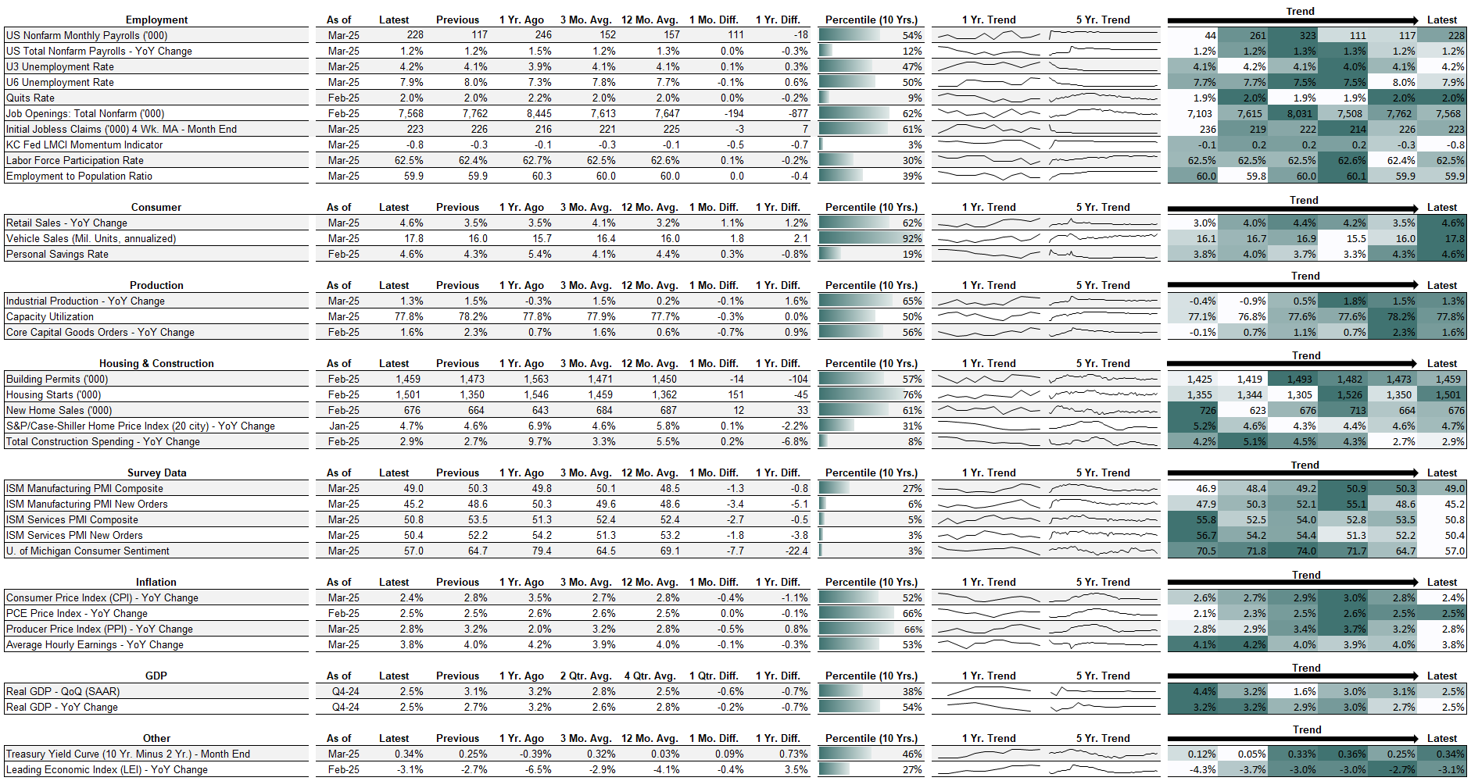
U.S. Economic Overview

Slide 11
U.S. Economic Expansions and Recessions
*Current
Expansion

Slide 12
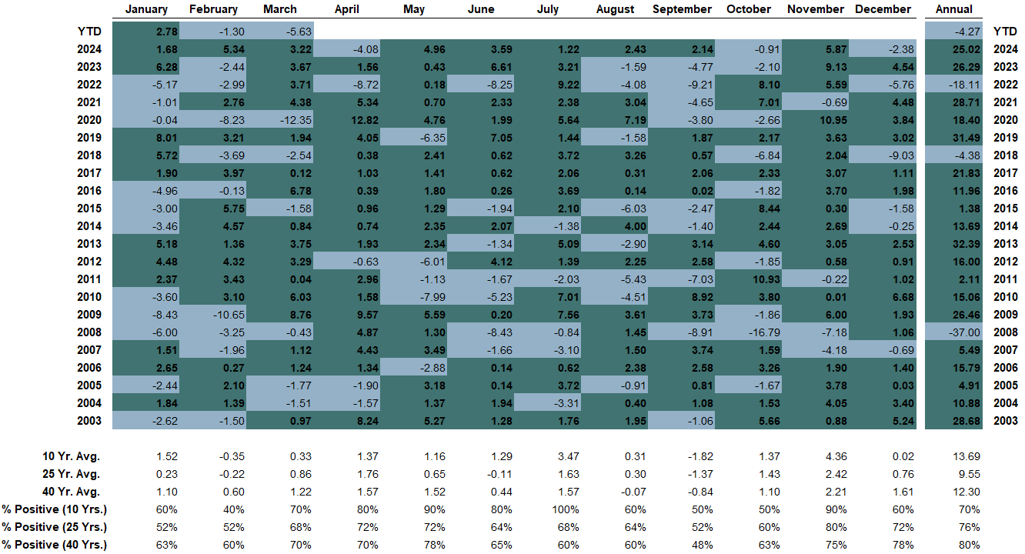
S&P 500 Historical Returns

Slide 13
Asset Class Historical Return Heat Map
 |  | Calendar Year Return |  |  |  |  |  |  |  |  |  |  |  | Annualized Return
 | Asset Class | YTD | 2024 | 2023 | 2022 | 2021 | 2020 | 2019 | 2018 | 2017 | 2016 | 2015 |  | 1-Year | 3-Year | 5-Year | 10-Year
 | US Large Cap | -4.27% | 25.02% | 26.29% | -18.11% | 28.71% | 18.40% | 31.49% | -4.38% | 21.83% | 11.96% | 1.38% |  | 8.25% | 9.06% | 18.59% | 12.50%
 | US Large Cap Growth | -8.47% | 36.07% | 30.03% | -29.41% | 32.01% | 33.47% | 31.13% | -0.01% | 27.44% | 6.89% | 5.52% |  | 10.46% | 7.74% | 18.70% | 13.99%
 | US Large Cap Value | 0.28% | 12.29% | 22.23% | -5.22% | 24.90% | 1.36% | 31.93% | -8.95% | 15.36% | 17.40% | -3.13% |  | 4.21% | 9.32% | 17.21% | 10.11%
 | US Mid Cap | -6.10% | 13.93% | 16.44% | -13.06% | 24.76% | 13.66% | 26.20% | -11.08% | 16.24% | 20.74% | -2.18% |  | -2.71% | 4.42% | 16.91% | 8.43%
 | US Small Cap | -8.93% | 8.70% | 16.05% | -16.10% | 26.82% | 11.29% | 22.78% | -8.48% | 13.23% | 26.56% | -1.97% |  | -3.38% | 0.71% | 15.09% | 7.52%
 | International Developed | 6.86% | 3.82% | 18.24% | -14.45% | 11.26% | 7.82% | 22.01% | -13.79% | 25.03% | 1.00% | -0.81% |  | 4.88% | 6.05% | 11.77% | 5.40%
 | Emerging Market Equities | 2.93% | 7.50% | 9.83% | -20.09% | -2.54% | 18.31% | 18.42% | -14.57% | 37.28% | 11.19% | -14.92% |  | 8.09% | 1.44% | 7.94% | 3.71%
 | REITs | 1.17% | 8.10% | 13.96% | -25.96% | 45.91% | -11.20% | 23.10% | -4.22% | 3.76% | 6.68% | 4.48% |  | 9.79% | -1.41% | 10.84% | 4.53%
 | Commodities | 8.88% | 5.38% | -7.91% | 16.09% | 27.11% | -3.12% | 7.69% | -11.25% | 1.70% | 11.77% | -24.66% |  | 12.28% | -0.77% | 14.51% | 2.77%
 | Gold | 18.21% | 26.62% | 12.82% | -0.74% | -4.28% | 20.95% | 18.03% | -2.81% | 12.79% | 7.75% | -10.88% |  | 39.42% | 16.29% | 13.18% | 9.23%
 | Intermediate-Term Treasurys | 3.89% | -0.70% | 3.58% | -14.89% | -3.07% | 9.98% | 8.50% | 0.90% | 2.55% | 1.05% | 1.63% |  | 4.65% | -0.88% | -2.52% | 0.87%
 | Long-Term Treasurys | 4.59% | -7.98% | 2.66% | -31.09% | -4.37% | 18.10% | 15.11% | -2.00% | 8.98% | 1.43% | -1.59% |  | 0.08% | -8.53% | -8.74% | -0.99%
 | TIPS | 4.17% | 1.84% | 3.90% | -11.85% | 5.96% | 10.99% | 8.43% | -1.26% | 3.01% | 4.68% | -1.44% |  | 6.17% | 0.06% | 2.36% | 2.51%
 | Mortgage-Backed Securities | 3.08% | 0.96% | 5.40% | -10.76% | -1.45% | 3.68% | 5.85% | 1.02% | 1.86% | 1.56% | 1.39% |  | 5.18% | 0.70% | -0.59% | 1.08%
 | Corporate IG Bonds | 2.31% | 2.13% | 8.52% | -15.76% | -1.04% | 9.89% | 14.54% | -2.51% | 6.42% | 6.11% | -0.68% |  | 4.90% | 1.14% | 1.51% | 2.43%
 | High Yield Corporate Bonds | 1.00% | 8.19% | 13.44% | -11.19% | 5.28% | 7.11% | 14.32% | -2.08% | 7.50% | 17.13% | -4.47% |  | 7.69% | 4.98% | 7.29% | 5.01%
 | US Aggregate Bonds | 2.78% | 1.25% | 5.53% | -13.01% | -1.54% | 7.51% | 8.72% | 0.01% | 3.54% | 2.65% | 0.55% |  | 4.88% | 0.52% | -0.40% | 1.46%
For each time frame, the heat map colors range from dark green (stronger relative performance) to white (weaker relative performance). There is a box around the return of the best performing asset class in each time period.

Slide 14
S&P 500 Drawdowns (1950 – 2025)
1987 Crash
2020 Pandemic Crash
1969-70 Crash
1973-74 Crash
Dot-Com Bubble Crash
2008-2009 Financial Crisis

Slide 15
S&P 500 Annual Total Return and Max Drawdown

Slide 16
Rolling S&P 500 Returns Since 1950
The chart shows the rolling 5, 10, and 15-year annualized returns for the S&P 500 (including dividend reinvestment) since 1950. Returns are through the end of each quarter. As an example, the most recent 5-year rolling return on this chart represents the annualized return from 4/1/2020 through 3/31/2025. The average return for each rolling chart is represented by the dashed black line. Shorter holding periods have larger variability in returns.

Slide 17
U.S. Companies Are Global. Some Sectors More than Others.
The S&P 500 is an index of U.S. companies, but 41% of revenue is generated outside of the U.S. The large cap index is comprised of global firms that are sensitive to what happens outside of our borders. The sectors that source the highest percentage of revenues outside of the U.S. are Technology (56%), Materials (51%), and Communication Services (48%). These sectors may be most at-risk if the trade war escalates further.

Slide 18
AI Demand Fueling Data Center Boom
There is a boom in the construction of data centers driven by AI capex spending. Artificial Intelligence requires vast amounts of computational power and data storage, increasing the need for data centers to provide computing infrastructure. Construction spending on data centers is up 39% over the last 12 months and up 339% since the beginning of this decade.

Slide 19
Economy Needs Private Employment Growth to Expand
Government jobs accounted for 22% of employment growth in 2023 and 2024, significantly higher than pre-pandemic levels in the mid-single digits. With government job growth expected to slow, the economy needs robust private employment growth. Private employment has increased by an average of 131,000 new jobs per month over the last 12 months, below the 2018-19 pre-pandemic average of 164,000.
2018-19 Average

Slide 20
Federal Employees are a Small Percentage of Labor Force
Federal government employment accounts for less than 2% of total employment, and this figure has trended lower for several decades. While DOGE-related cuts are likely to reduce federal government employment, it likely won’t have a sizable long-term effect on the broader labor market. Within total government employment, about 3 million work for the Federal government, while roughly 20.6 million work at the state and local level.

Slide 21
Disclosures
About Cetera® Investment Management
Cetera Investment Management LLC is an SEC registered investment adviser owned by Cetera Financial Group®. Cetera Investment Management provides market perspectives, portfolio guidance, model management, and other investment advice to its affiliated broker-dealers, dually registered broker-dealers and registered investment advisers.
About Cetera Financial Group®
Cetera Financial Group (Cetera) is a leading financial advice firm. It empowers the delivery of an Advice-Centric Experience® to individuals, families and businesses across the country through independent financial advisors as well as trusted tax professionals and banks and credit unions. Located at 655 W. Broadway, 11th Floor, San Diego, CA 92101.
About Avantax
Avantax, Inc. (Avantax) is a wholly owned subsidiary of Aretec Group, Inc. (dba Cetera Holdings). Avantax is a unique community within Cetera Holdings. Avantax Investment Services, Inc., a subsidiary of Avantax, Member FINRA / SIPC. Located at 3200 Olympus Blvd, Suite 100, Dallas, TX, 75019. Avantax and Cetera Financial Group are under common ownership.
Comprehensive services include: wealth management solutions, retirement plan solutions, advisory services, practice management support, innovative technology, marketing guidance, regulatory support, and market research.
“Cetera Financial Group” refers to the network of independent retail firms encompassing, among others, Cetera Advisors LLC, Cetera Advisor Networks LLC, Cetera Investment Services LLC (marketed as Cetera Financial Institutions or Cetera Investors), and Cetera Financial Specialists LLC. All firms are members FINRA / SIPC.
Individuals affiliated with Cetera firms are either Registered Representatives who offer only brokerage services and receive transaction-based compensation (commissions), Investment Adviser Representatives who offer only investment advisory services and receive fees based on assets, or both Registered Representatives and Investment Adviser Representatives, who can offer both types of services.

Slide 22
Disclosures (cont.)
The material contained in this document was authored by and is the property of Cetera Investment Management LLC. Cetera Investment Management provides investment management and advisory services to a number of programs sponsored by affiliated and non-affiliated registered investment advisers. Your registered representative or investment adviser representative is not registered with Cetera Investment Management and did not take part in the creation of this material. He or she may not be able to offer Cetera Investment Management portfolio management services.
Nothing in this presentation should be construed as offering or disseminating specific investment, tax, or legal advice to any individual without the benefit of direct and specific consultation with an investment adviser representative authorized to offer Cetera Investment Management services. Information contained herein shall not constitute an offer or a solicitation of any services. Past performance is not a guarantee of future results.
For more information about Cetera Investment Management strategies and available advisory programs, please reference the Cetera Investment Management LLC Form ADV disclosure brochure and the disclosure brochure for the registered investment adviser your adviser is registered with. Please consult with your adviser for his or her specific firm registrations and programs available.
No independent analysis has been performed and the material should not be construed as investment advice. Investment decisions should not be based on this material since the information contained here is a singular update, and prudent investment decisions require the analysis of a much broader collection of facts and context. All information is believed to be from reliable sources; however, we make no representation as to its completeness or accuracy. The opinions expressed are as of the date published and may change without notice. Any forward-looking statements are based on assumptions, may not materialize, and are subject to revision.
All economic and performance information is historical and not indicative of future results. The market indices discussed are not actively managed. Investors cannot directly invest in unmanaged indices. Please consult your financial advisor for more information.
Additional risks are associated with international investing, such as currency fluctuations, political and economic instability, and differences in accounting standards. Emerging markets involve heightened risks related to the same factors as well as increased volatility and lower trading volume.

Slide 23
Definitions
The Recession Riskometer is the average reading of ten economic indicators – Unemployment, ISM Manufacturing and Non-Manufacturing Indexes, Industrial Production Growth, Building Permits Growth, Temporary Staffing Employment Growth, Real Retail Sales Growth, Consumer Confidence as measured by the University of Michigan, Philadelphia Federal Reserve’s Leading Indicator for the U.S. Index, as well as the difference between 10- and 2-year Treasury rates.
The Economic Trend Signal measures the average of whether each of the ten indicators in the Recession Riskometer are improving, neutral or declining in their most recent reading as compared to historical data.
The U3 Unemployment Rate measures the percentage of people without jobs who are actively seeking work. This is often the officially quoted unemployment rate. The U6 Unemployment Rate expands the definition of U3 by including "discouraged workers", or those who have stopped looking for work because current economic conditions make them believe that no work is available for them, other "marginally attached workers", or those who would like and are able to work, but have not looked for work recently, as well as part-time workers who want to work full-time, but cannot due to economic reasons.
The ISM Manufacturing Index is based on surveys of over 400 manufacturing firms across 20 industries by the Institute of Supply Management. Equal weight is given to responses in five areas - new orders, production, supplier deliveries, employment and inventories. Generally, a reading over 50 indicates expansion, and a reading in the low 40's suggests recessionary conditions. Changes in the index are also helpful in gauging the direction of economic growth.
The ISM Services Index is based on surveys of over 350 non-manufacturing firms in 17 industries representing over 80% of the U.S. economy by the Institute of Supply Management. The survey shows the percentage of managers reporting higher activity, lower activity or no change in the following areas: business activity, new orders, employment, supplier deliveries, backlog of orders, new export orders, inventory change, inventory sentiment, imports, and prices.
Industrial Production and Capacity Utilization is measured monthly by the United States Federal Reserve, based on hours worked by industrial-sector employees. The report shows total amount of US industrial production as a percentage compared to a baseline year. It also offers percentage changes from month to month and year to year, and a breakdown of production by industry grouping.

Slide 24
Definitions (cont.)
Building Permits are a measure of the issuance of permits to build new housing units (single and multi-family units). Building Permits Growth is a measure of the total year-over-year percentage change of the 3-month average of building permits. This indicator leads housing construction and provides a signal for potential weakness in the housing sector when it is declining.
The US Bureau of Labor Statistics surveys the temporary staffing industry is surveyed in its Professional and Business Services. They produce a report on Temporary Help Employment - changes in this figure are often used as a predictor of changes in future employment. Changes in Temporary Help Employment is a coincident economic indicator.
Real Retail Sales Growth is a measure of the total year-over-year change in retail and food sales adjusted for inflation using the Consumer Price Index. Real Retail Sales figures provided are the year-over-year change of the 3-month average. By neutralizing the impact of inflation, the year-over-year change in retail and food sales provides a better view into consumer spending strength because growth in this figure indicates stronger demand without the impact of rising prices. Real Retail and Food Sales typically decline heading into recession, and a weaker read is a concern for the economy.
The University of Michigan Consumer Sentiment Index is survey of consumer confidence conducted via telephone surveys to gather information on consumer expectations regarding the overall economy.
The Leading Economic Index (LEI) is a composite index of several U.S. economic indicators that lead the economy including building permits, manufacturers’ new orders, and consumer expectations. This index is often used as a proxy to gauge where the economy is heading over the next several months because it measures the strength of leading indicators. The Leading Economic Index historically has declined ahead of recessions and trends higher during expansions.
The difference (spread) between the yields of the 10-Year and 2-Year maturity Treasury bonds. Often referred to as the 10-Year/2-Year spread, this metric is one of the early and reliable predictors of recession. Under normal conditions the 10-Year/2-Year spread is positive, as investors demand higher risk premium for longer -term bonds. Spreads are usually wider early in an economic recovery and narrow as growth sets in. As recession becomes more likely, spreads tend to move toward zero or turn negative - this occurs because in periods when economic growth slows inflation decreases and demand for credit declines, pushing long term rates lower.

Slide 25
Definitions (cont.)
A Price/Earnings (P/E) ratio is a measure for equity analysis. It is calculated by dividing the current market price of a stock by its earning per share.
A Price/Book (P/B) ratio is a measure for equity analysis. It is calculated by dividing the current market price of a stock by the most recent book value per share.
The yield curve is a graphical representation of several yields or interest rates across different bond maturities. Typical maturities include 3-month, 6-month, 1-year, 2-year, 5-year, 10-year and 30-year.
The High-Yield - US Treasury spread is the percentage difference in current yields of various classes of high-yield bonds compared against U.S. Treasury bonds.
Percentile is a method of ranking a metric versus its history by measuring the percentage of group observations equal to or lower than it. As an example, if a metric scores in the 80th percentile, it is greater than 80% of all other group observations over the stated time period and lower than 20% of the group observations.
Standard deviation is a statistical method used to gauge asset risk based on measuring the dispersion in returns relative to the average over a specified period of time.
The Global Industry Classification Standard (GICS) is a classification system for equities, it is used by various equity indexes to classify domestic and international stocks and breaks equites down to 11 sectors, which Morningstar breaks down into three groups as described below. Stocks in Energy, Industrials, Information Technology and Telecommunication Services are classified as Sensitive. Consumer Discretionary, Financials and Materials are defined as Cyclical, and Consumer Staples, Health Care and Utilities are classified as Defensive.

Slide 26
Definitions (cont.)
Sensitive - The sensitive super sector includes industries which ebb and flow with the overall economy, but not severely so. Sensitive industries fall between the defensive and cyclical industries as they are not immune to a poor economy but they also may not be as severely impacted by a poor economy as industries in the cyclical super sector. In general, the stocks in these industries move closely to the direction of the economy.
Cyclical - The cyclical super sector includes industries significantly impacted by economic shifts. When the economy is prosperous these industries tend to expand and when the economy is in a downturn these industries tend to shrink. In general, the stocks in these industries expand faster when the economy is growing and also contract faster in a recession.
Defensive - The defensive super sector includes industries that are relatively immune to economic cycles. These industries provide services that consumers require in both good and bad times, such as healthcare and utilities. In general, the stocks in these industries are not very sensitive to the direction of the economy.
A drawdown is a measure of the decline from a peak point for an investment or an index. It is typically quoted for a specified period of time, and measured as the percentage between the peak and the subsequent trough in value. The duration of a drawdown indicates the time elapsed before the investment returns to the starting peak value.
A simple moving average of an investment or an index calculates its average price for a set period to the most recent price. The moving average is updated each successive period by deleting the price from the earliest date and adding the newly available most recent price. The result is a trend line for price movements, which may be an indicator of market sentiment. Generally, if the moving average is trending higher and the investment or index price rises above the moving average, sentiment is considered to be bullish, as prices are likely to continue higher, and it may be a good time to buy. If the moving average trend slopes downward, and the investment price is below the moving average, this may be a bearish, or sell signal, as prices may continue to move down.

Slide 27
Index Definitions
The S&P 500 is an index of 500 stocks chosen for market size, liquidity and industry grouping (among other factors) designed to be a leading indicator of U.S. equities and is meant to reflect the risk/return characteristics of the large cap universe.
The S&P Growth Index is a float adjusted, market capitalization weighted index of 317 stocks drawn from the S&P 500 Index that exhibit strong growth characteristics. S&P Dow Jones Indexes uses three factors to measure growth: sales growth, the ratio of earnings change to price, and momentum.
The S&P Value Index is a float adjusted, market capitalization weighted index of 364 stocks drawn from the S&P 500 Index that exhibit strong value characteristics. S&P Dow Jones Indexes uses three factors to measure value: the ratios of book value, earnings and the sales to price sales metric.
The S&P MidCap 400 provides investors with a benchmark for mid-sized companies. The index, which is distinct from the large-cap S&P 500®, measures the performance of 400 mid-sized companies, representing more than 7% of available market cap.
The S&P MidCap 400 Growth Index represents the growth companies of the S&P MidCap 400 Index which itself is composed of mid-cap stocks from the broad U.S. equity market. Growth companies are identified by three factors: book value to price ratio, earnings to price ratio, and sales to price ratio.
The S&P MidCap 400 Value Index represents the value companies of the S&P MidCap 400 Index which itself is composed of mid-cap stocks from the broad U.S. equity market. Value companies are identified by three factors: book value to price ratio, earnings to price ratio, and sales to price ratio.
The S&P SmallCap 600 measures the small-cap segment of the U.S. equity market. Introduced in 1994, the index is designed to track the performance of 600 small-size companies in the U.S, reflecting this market segment’s distinctive risk and return characteristics. The index measures a segment of the market that is typically known for less liquidity and potentially less financial stability than large-caps, the index was constructed to be an efficient benchmark composed of small-cap companies that meet investability and financial viability criteria.
The S&P SmallCap 600 Growth Index represents the growth companies of the S&P S&P SmallCap 600 Index which itself is composed of small cap stocks from the broad U.S. equity market. Growth companies are identified by three factors: book value to price ratio, earnings to price ratio, and sales to price ratio.

Slide 28
Index Definitions (cont.)
The S&P SmallCap 600 Value Index represents the value companies of the S&P SmallCap 600 Index which itself is composed of small-cap stocks from the broad U.S. equity market. Value companies are identified by three factors: book value to price ratio, earnings to price ratio, and sales to price ratio.
The MSCI EAFE is designed to measure the equity market performance of developed markets (Europe, Australasia, Far East) excluding the U.S. and Canada. The Index is market-capitalization weighted.
The MSCI EAFE Growth index represents large and mid-cap securities exhibiting overall growth style characteristics across Developed Markets countries around the world, excluding the U.S. and Canada.
The MSCI EAFE Value index represents large and-mid cap securities exhibiting overall value style characteristics across Developed Markets countries around the world, excluding the U.S. and Canada.
The MSCI Emerging Markets is designed to measure equity market performance in global emerging markets. It is a float-adjusted market capitalization index.
The MSCI Europe Index is a free float-adjusted market capitalization index that is designed to measure developed market equity performance in Europe.
The MSCI Pacific Index captures large and mid-cap representation across five Developed Markets (DM) countries in the Pacific region. With 470 constituents, the index covers approximately 85% of the free float-adjusted market capitalization in each country.
The MSCI ACWI is a free float‐adjusted market capitalization weighted index that is designed to measure the equity market performance of developed and emerging markets. The MSCI ACWI consists of 46 country indexes comprising 23 developed and 23 emerging market country indexes. The developed market country indexes included are: Australia, Austria, Belgium, Canada, Denmark, Finland, France, Germany, Hong Kong, Ireland, Israel, Italy, Japan, Netherlands, New Zealand, Norway, Portugal, Singapore, Spain, Sweden, Switzerland, the United Kingdom and the United States. The emerging market country indexes included are: Brazil, Chile, China, Colombia, Czech Republic, Egypt, Greece, Hungary, India, Indonesia, Korea, Malaysia, Mexico, Peru, Philippines, Poland, Qatar, Russia, South Africa, Taiwan, Thailand, Turkey and United Arab Emirates.

Slide 29
Index Definitions (cont.)
The S&P 500® Consumer Discretionary Index comprises those companies included in the S&P 500 that are classified as members of the GICS® Consumer Discretionary sector.
The S&P 500® Consumer Staples Index comprises those companies included in the S&P 500 that are classified as members of the GICS® Consumer Staples sector.
The S&P 500® Energy Index comprises those companies included in the S&P 500 that are classified as members of the GICS® Energy sector.
The S&P 500® Financials Index comprises those companies included in the S&P 500 that are classified as members of the GICS® Financials sector.
The S&P 500® Health Care Index comprises those companies included in the S&P 500 that are classified as members of the GICS® Health Care sector.
The S&P 500® Industrials Index comprises those companies included in the S&P 500 that are classified as members of the GICS® Industrials sector.
The S&P 500® Information Technology Index comprises those companies included in the S&P 500 that are classified as members of the GICS® Information Technology sector.
The S&P 500® Materials Index comprises those companies included in the S&P 500 that are classified as members of the GICS® Materials sector.
The S&P 500® Real Estate Index comprises those companies included in the S&P 500 that are classified as members of the GICS® Real Estate sector.
The S&P 500® Telecommunication Services Index comprises those companies included in the S&P 500 that are classified as members of the GICS® Telecommunication Services sector.
The S&P 500® Utilities Index comprises those companies included in the S&P 500 that are classified as members of the GICS® Utilities sector.

Slide 30
Index Definitions (cont.)
The Bank of America Merrill Lynch U.S. Treasury Bill 3 Month index measures the performance of a single issue of outstanding treasury bill which matures closest to, but not beyond, three months from the rebalancing date. The issue is purchased at the beginning of the month and held for a full month; at the end of the month that issue is sold and rolled into a newly selected issue.
The Bloomberg U.S. Treasury: 1-3 Year Index measures the performance of U.S. Treasury securities with remaining maturities of one to three years.
The Bloomberg U.S. Treasury: 7-10 Year Index measures the performance of U.S. Treasury securities that have a remaining maturity of at least seven years and less than 10 years.
The Bloomberg U.S. Treasury: U.S. TIPS Index includes all publicly issued, U.S. Treasury inflation-protected securities that have at least one year remaining to maturity, are rated investment grade, and have $250 million or more of outstanding face value.
The Bloomberg U.S. Municipal Bond Index is an unmanaged, market-value-weighted index of investment-grade municipal bonds with maturities of one year or more.
The Bloomberg GNMA Index measures the performance of Government National Mortgage Association (GNMA or “Ginnie Mae”) bonds. It is a subset of the Bloomberg Barclays U.S. Aggregate index.
The Bloomberg U.S. Corporate (Investment Grade) Bond Index measures the investment grade, fixed-rate, taxable corporate bond market. It includes USD-denominated securities publicly issued by U.S. and non-US private-sector industrial, utility and financial issuers. Certificates of deposit are also included. Launched in July 1973, securities included must be rated investment grade (Baa3/BBB-/BBB- or higher). Eligible senior and subordinated corporate securities must have at least one year until final maturity, but in practice the index holdings has a fluctuating average life of around 10.75 years. The index is unhedged and rebalances monthly.
The Bloomberg U.S. Corporate High-Yield Index measures the market of USD-denominated, non-investment grade, fixed-rate, taxable corporate bonds. Securities are classified as high-yield if the middle rating of Moody's, Fitch, and S&P is Ba1/BB+/BB+ or below, excluding emerging market debt.

Slide 31
Index Definitions (cont.)
The Bloomberg U.S. Aggregate 1-3 Years Index consists of publicly issued investment grade corporate, US Treasury and government agency securities with remaining maturities of one to three years.
The Bloomberg Capital U.S. Aggregate Bond Index, which was originally called the Lehman Aggregate Bond Index, is a broad based flagship benchmark that measures the investment grade, US dollar-denominated, fixed-rate taxable bond market. The index includes Treasuries, government–related and corporate debt securities, MBS (agency fixed-rate and hybrid ARM pass-throughs), ABS and CMBS (agency and non-agency) debt securities that are rated at least Baa3 by Moody’s and BBB- by S&P. Taxable municipals, including Build America bonds and a small amount of foreign bonds traded in U.S. markets are also included. Eligible bonds must have at least one year until final maturity, but in practice the index holdings has a fluctuating average life of around 8.25 years. This total return index, created in 1986 with history backfilled to January 1, 1976, is unhedged and rebalances monthly.
The Bloomberg Global Treasury ex U.S. Bond Index consists of those securities included in the Barclays Global Aggregate Bond Index that are Treasury securities, with the U.S. excluded. The Barclays Global Aggregate Bond Index is comprised of several other Barclays indexes that measure fixed income performance of regions around the world.
The JP Morgan Emerging Markets Bond Index (EMBI) Global Diversified measures the performance of fix-rate for external-currency denominated debt instruments including Brady bonds, loans, Eurobonds in emerging markets. Countries covered are Argentina, Brazil, Bulgaria, Mexico, Morocco, Nigeria, the Philippines, Poland, Russia, and South Africa. It covers more of the eligible instruments than the EMBI+ by relaxing somewhat the strict EMBI+ limits on secondary market trading liquidity.
The Bloomberg Commodity Index is a broadly diversified index that measures 22 exchange-traded futures on physical commodities in five groups (energy, agriculture, industrial metals, precious metals, and livestock), which are weighted to account for economic significance and market liquidity. No single commodity can comprise less than 2% or more than 15% of the index; and no group can represent more than 33% of the index. However, between rebalancings, group weightings may fluctuate to levels outside the limits. The index rebalances annually, weighted 2/3 by trading volume and 1/3 by world production.

Slide 32
Index Definitions (cont.)
The Bloomberg US Treasury 20+ Year index represents the 20+ Year component of the Barclays US Treasury Index. Included securities must have at least 20 years to final maturity regardless of call features, and least $250 million par amount outstanding. They must be rated investment grade (Baa3/BBB- or higher) by at least two of the following ratings agencies: Moody's, S&P, Fitch.
The Dow Jones U.S. Select REIT Index tracks the performance of publicly traded REITs and REIT-like securities and is designed to serve as a proxy for direct real estate investment, in part by excluding companies whose performance may be driven by factors other than the value of real estate. The index is a subset of the Dow Jones U.S. Select Real Estate Securities Index (RESI), which represents equity real estate investment trusts (REITs) and real estate operating companies (REOCs) traded in the U.S.
The S&P GSCI Gold Index, a sub-index of the S&P GSCI, provides investors with a reliable and publicly available benchmark tracking the COMEX gold future. The index is designed to be tradable, readily accessible to market participants, and cost efficient to implement. The more widely tracked S&P GSCI index is recognized as a leading measure of general price movements and inflation in the world economy. The index represents commodity market beta is world-production weighted and is designed to be investable by including the most liquid commodity futures.
Federal funds rate is the interest banks charge one another when lending reserve balances on an overnight basis. Typically banks with reserve capital above the minimum required to be held at the Federal Reserve will lend the excess to banks who need to meet minimums.
Treasury yield is the return on investment of U.S. government's debt obligations. Short-term Treasury bills offer no interest payments and are issued at discount from face value. The yield of the three-month Treasury bill is the difference between the discount price and face value, expressed as an annualized percentage rate.
Longer-term Treasury notes are issued for maturities from 1-10 years and offer an interest (or coupon) payment. They may be purchased at premium or discount from face value. The yield on 1- and 2- year Treasury notes is based on their coupon payment and face value, adjusted upward if the note was purchased at discount, and downward if the note was purchased at a premium. It is also expressed as an annualized percentage rate.

Slide 33
Index Definitions (cont.)
Factor Indices are designed to reflect the performance of stocks representing a specific set of factor characteristics. Factor-specific indexes are calculated based on Russell and FTSE index universes. The cut-off date for the calculation of all factor data is the close of business on the last business day of the month prior to the review month. Detail on the calculation of each individual factor follow:
Momentum is defined as the cumulative total local return, calculated over the period that starts twelve months prior to the effective date, and ends the Monday following the third Friday of the previous month. A full period history is required to calculate Momentum. Country Relative Momentum is calculated in excess of the country median stock level of Momentum.
Quality is defined as a composite of Profitability and Leverage. Indexes derived from each eligible universe consider three individual measures of Profitability and a single measure of Leverage. Annual reported financial statement items are sourced from a third-party data provider.
Size is calculated as the natural logarithm of each company’s full market capitalization in USD. Shares in issue as of the review effective date and price and foreign exchange rates as of the data cut-off date are used to calculate each company’s full market capitalization.
Value is represented by a composite of three common valuation measures: • Cash-flow Yield = Latest Annual Cash-Flow / Full Market Capitalization • Earnings Yield = Latest Annual Net Income / Full Market Capitalization • Sales to Price = Latest Annual Sales / Full Market Capitalization Sales to Price is calculated in excess of the country median stock level. Annual measures of cashflow, net income and sales are sourced from a third-party data provider.
Volatility is defined as the standard deviation of five years of weekly (Wednesday to Wednesday) total local returns prior to the rebalance month. A minimum of 52 weekly return observations are required to calculate volatility. Country Relative Volatility is calculated in excess of the country median stock level of Volatility.
Yield is calculated as the natural logarithm of each company’s twelve-month trailing dividend yield. Companies whose trailing dividend yield is zero are assigned a negative normalized score (Z-Score).

Slide 34
Asset Class Indexes
Asset Class Index
US Large Cap S&P 500
US Large Cap Growth S&P 500 Growth
US Large Cap Value S&P 500 Value
US Mid Cap S&P Midcap 400
US Small Cap S&P SmallCap 600
International Developed MSCI EAFE
Emerging Market Equities MSCI Emerging Markets
REITs DJ US Select REIT
Commodities Bloomberg Commodities
Gold S&P GSCI Gold
Intermediate-Term Treasurys Bloomberg US Treasury 7-10 Yr
Long-Term Treasurys Bloomberg US Treasury 20+ Yr
TIPS Bloomberg US Treasury US TIPS
Mortgage-Backed Securities Bloomberg GNMA
Corporate IG Bonds Bloomberg US Corporate IG
High Yield Corporate Bonds Bloomberg US Corporate High Yield
US Aggregate Bonds Bloomberg US Aggregate Bond

Slide 35
Data Sources
Economic Indicator Source
Nonfarm Monthly Payrolls ('000) U.S. Bureau of Labor Statistics
Total Nonfarm Payrolls - YoY Change U.S. Bureau of Labor Statistics
U3 Unemployment Rate U.S. Bureau of Labor Statistics
U6 Unemployment Rate U.S. Bureau of Labor Statistics
Quit Rate U.S. Bureau of Labor Statistics
Job Openings: Total Nonfarm Payroll U.S. Bureau of Labor Statistics
Initial Jobless Claims ('000) 4 Wk. MA - Month End U.S. Employment and Training Administration
KC Fed LMCI Momentum Indicator Federal Reserve Bank of Kansas City
Labor Force Participation Rate U.S. Bureau of Labor Statistics
Employment to Population Ratio U.S. Bureau of Labor Statistics
Temporary Help Employment U.S. Bureau of Labor Statistics
Retail Sales - YoY Change U.S. Bureau of the Census
Vehicle Sales (Mil. Units, annualized) U.S. Bureau of Economic Analysis
Personal Savings Rate U.S. Bureau of Economic Analysis
Real Retail Sales (3MMA) - YoY Change Federal Reserve Bank of St. Louis
Industrial Production - YoY Change Board of Governors of the Federal Reserve System (US)
Capacity Utilization Board of Governors of the Federal Reserve System (US)
Core Capital Goods Orders - YoY Change U.S. Bureau of the Census
Building Permits ('000) U.S. Bureau of the Census
Housing Starts ('000) U.S. Bureau of the Census

Slide 36
Data Sources (cont.)
Economic Indicator Source
New Home Sales U.S. Bureau of the Census
S&P/Case-Shiller Home Price Index (20 city) - YoY Change S&P Dow Jones Indices LLC
Total Construction Spending - YoY Change U.S. Bureau of the Census
ISM Manufacturing Composite PMI Institute for Supply Management
ISM Manufacturing New Orders Institute for Supply Management
ISM Services Composite PMI Institute for Supply Management
ISM Services New Orders Institute for Supply Management
U. of Michigan Consumer Sentiment University of Michigan
Consumer Price Index (CPI) - YoY Change U.S. Bureau of Labor Statistics
Personal Consumption Expenditure (PCE) - YoY Change U.S. Bureau of Economic Analysis
Producer Price Index (PPI) - YoY Change U.S. Bureau of Labor Statistics
Average Hourly Earnings - YoY Change U.S. Bureau of Labor Statistics
Real GDP – QoQ (SAAR) U.S. Bureau of Economic Analysis
Real GDP – YoY Change U.S. Bureau of Economic Analysis
Treasury Yield Curve (10-Yr. Minus 2-Yr.) Federal Reserve Bank of St. Louis
Leading Economic Index (LEI) – YoY Change The Conference Board

Slide 37
Thank You.

